Slide 1
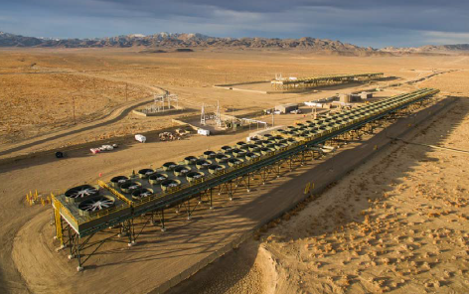
WSUP20-0025
Ormat Geothermal
Washoe County Board of Adjustment
Feb 4, 2021

Slide 2
Request
Applicant is requesting to establish a 9-acre restricted market temporary aggregate facility to serve WSUP20-0013.
Requests to vary paved parking and maneuvering standards and landscaping

Slide 3
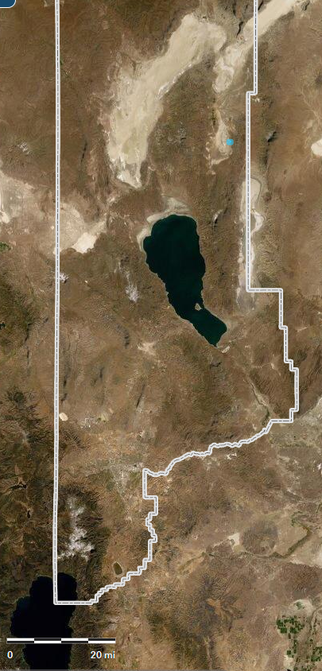
Vicinity Map
Aggregate Facility

Slide 4
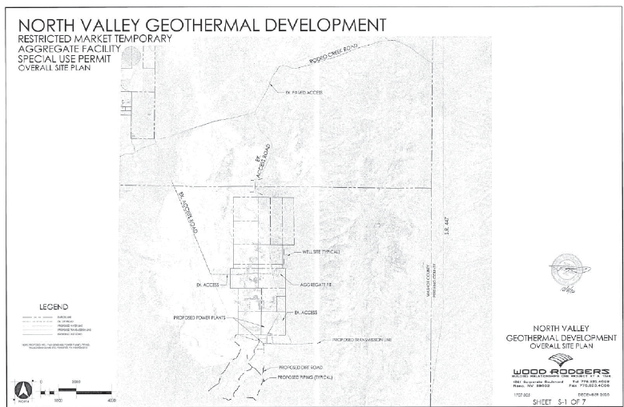
Local Vicinity Map
Aggregate Facility

Slide 5
Background
  Proposed use will serve future Ormat Geothermal Facility – WSUP20-0013 (Pending regional approval)
  Originally an aggregate pit for SPB8-31-91
    Lapsed 12/31/2001

Slide 6
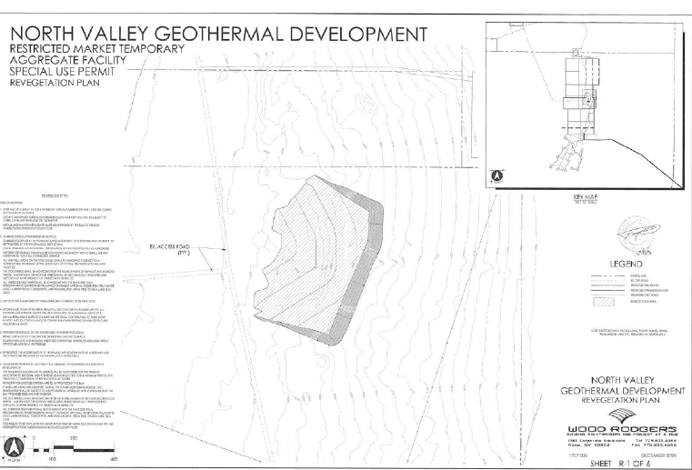
Site Plan

Slide 7
Article 332 - Aggregate Facilities
Article 302/304 defers to 332
Allowed in any regulatory zone with an approved special use permit

Slide 8
Article 332 – Aggregate Facilities
Special Review Consideration | Complies | Conditions of Approval Provided
Conservation of topsoil | Yes | Yes
Protection of water resources | Yes | Yes
Conservation of habitats | Yes | Yes
Erosion | Yes | Yes
Drainage and sedimentation | No | Yes, Engineering
Visual and noise buffering | Yes | Yes
Traffic Impacts | Yes | Yes
Restoration and/or reuse of site | Yes | Yes
Bonding program | Yes | Yes
Preservation of resources | Yes | Yes

Slide 9
Article 410 – Parking and Loading
Applicant is requesting to waive all parking standards.
  No required spaces
  10 loading spaces
Proposed Conditions
  Staff agrees to waive all parking standards for this facility
  Does not match the character of the proposed use.

Slide 10
Article 412 - Landscaping
Request to waive all formal landscaping requirements
  Required landscaping of 10% of developed site area and 1 tree every 50ft of road.
Proposed Conditions
  Staff agrees to waive the formal landscaping requirements required per 110.412.45(a-d)
  Landscaping does not match the nature of use or character of surrounding area

Slide 11
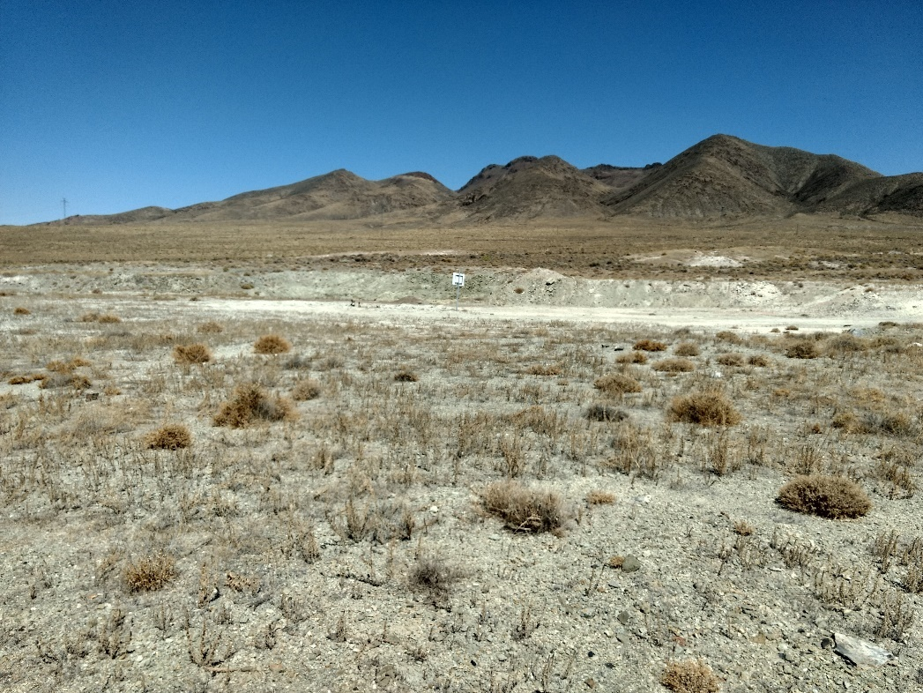
Existing Conditions

Slide 12
Article 438 - Grading
Bulk of grading already covered in BCC approval of WSUP20-0013 Nov 13, 2020
Applicant is requesting finished recontoured slopes of 2:1.
  This does not comply with 110.438.45(a) and High Desert Policy 6.2
  Staff does not support varying this standard as it would require a Master Plan amendment

Slide 13
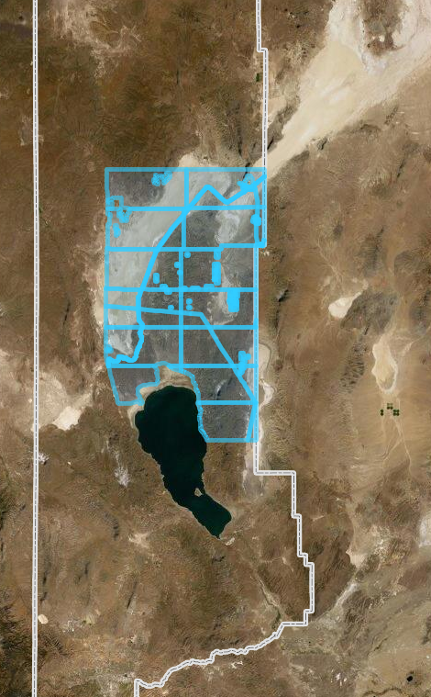
Public Notice
Notice was sent to 36 affected property owners (blue) within 94,250 feet of the site.

Slide 14
Citizen Advisory Board Meeting
Gerlach/Empire CAB met Jan 11, 2021
CAB strongly in favor of proposed reclamation of a previously disturbed area.
  Voted unanimously in favor

Slide 15
Special Use Permit Findings
Consistency. That the proposed use is consistent with the action programs, policies, standards and maps of the Master Plan and the High Desert Area Plan.
Improvements. That adequate utilities, roadway improvements, sanitation, water supply, drainage, and other necessary facilities have been provided, the proposed improvements are properly related to existing and proposed roadways, and an adequate public facilities determination has been made in accordance with Division Seven.
Site Suitability. That the site is physically suitable for renewable energy generation use, and for the intensity of such a development.
Issuance Not Detrimental. That issuance of the permit will not be significantly detrimental to the public health, safety or welfare; injurious to the property or improvements of adjacent properties; or detrimental to the character of the surrounding area.
Effect on a Military Installation. Issuance of the permit will not have a detrimental effect on the location, purpose or mission of the military installation.

Slide 16
Recommendation
Those agencies which reviewed the application recommended conditions to address applicable codes and impacts associated with the project. After a thorough analysis and review, staff recommends that the Board of Adjustment carefully consider all aspects of Special Use Permit number WSUP20-0025 and the nature of the stringent recommended conditions of approval and approve the requested Special Use Permit.

Slide 17
Possible Motion – Special Use Permit
APPROVAL: I move that, after giving reasoned consideration to the information contained in the staff report and information received during the public hearing, the Washoe County Board of Adjustment approve with conditions Special Use Permit Case Number WSUP20-0025 for Orni 36 LLC , having made all five findings in accordance with Washoe County Code Section 110.810.30:
1. Consistency. That the proposed use is consistent with the action programs, policies, standards and maps of the Master Plan and the Name of Area Plan;
2. Improvements. That adequate utilities, roadway improvements, sanitation, water supply, drainage, and other necessary facilities have been provided, the proposed improvements are properly related to existing and proposed roadways, and an adequate public facilities determination has been made in accordance with Division Seven;
3. Site Suitability. That the site is physically suitable for restricted market temporary aggregate facility and for the intensity of such a development;
4. Issuance Not Detrimental. That issuance of the permit will not be significantly detrimental to the public health, safety or welfare; injurious to the property or improvements of adjacent properties; or detrimental to the character of the surrounding area;
5. Effect on a Military Installation. Issuance of the permit will not have a detrimental effect on the location, purpose or mission of the military installation.

